Slide 1
Experiment No.3
3.DSB-SC Modulation and Demodulation

Slide 2
DSBSC Modulation:
In the process of Amplitude Modulation, the modulated wave consists of the carrier wave and two sidebands. The modulated wave has the information only in the sidebands. Sideband is nothing but a band of frequencies, containing power, which are the lower and higher frequencies of the carrier frequency.
The transmission of a signal, which contains a carrier along with two sidebands can be termed as Double Sideband Full Carrier system or simply DSBFC. It is plotted as shown in the following figure.

Slide 3
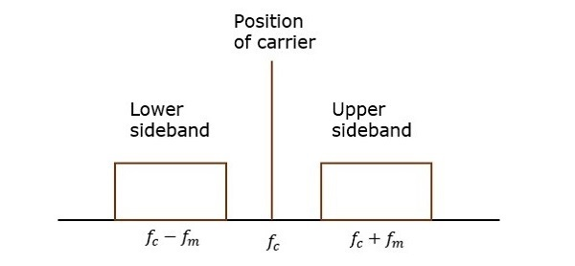
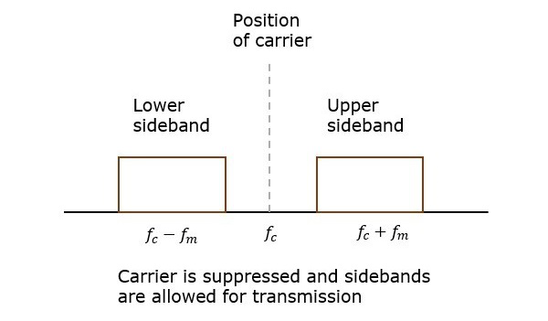
DSBSC Modulation:
However, such a transmission is inefficient. Because, two-thirds of the power is being wasted in the carrier, which carries no information.
If this carrier is suppressed and the saved power is distributed to the two sidebands, then such a process is called as Double Sideband Suppressed Carrier system or simply DSBSC. It is plotted as shown in the following figure.

Slide 4
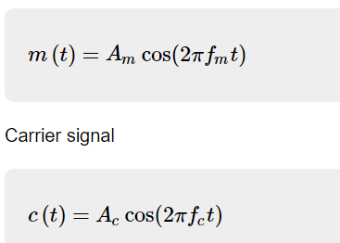
Mathematical Expressions:
Let us consider the same mathematical expressions for modulating and carrier signals as we have considered in the earlier chapters.
i.e., Modulating signal

Slide 5
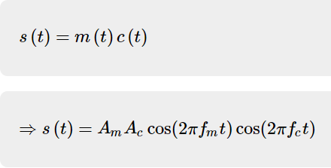

Mathematically, we can represent the equation of DSBSC wave as the product of modulating and carrier signals.
Bandwidth of DSBSC Wave
We know the formula for bandwidth (BW) is

Slide 6
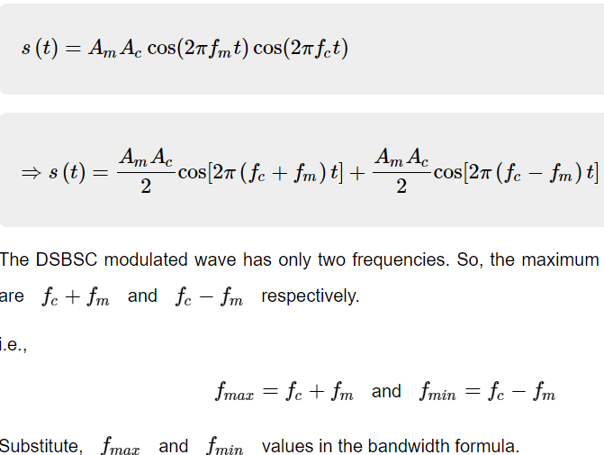
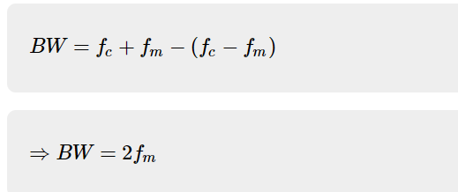
Consider the equation of DSBSC modulated wave.

Slide 7
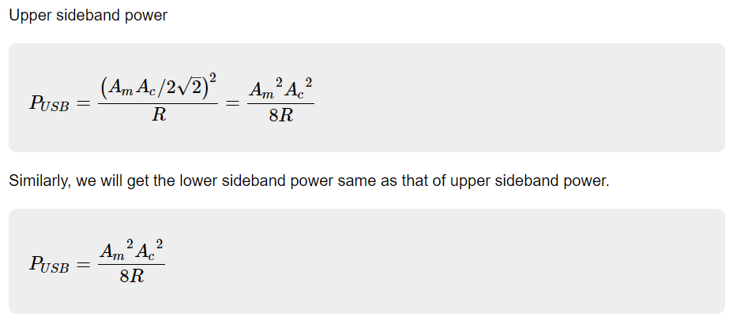
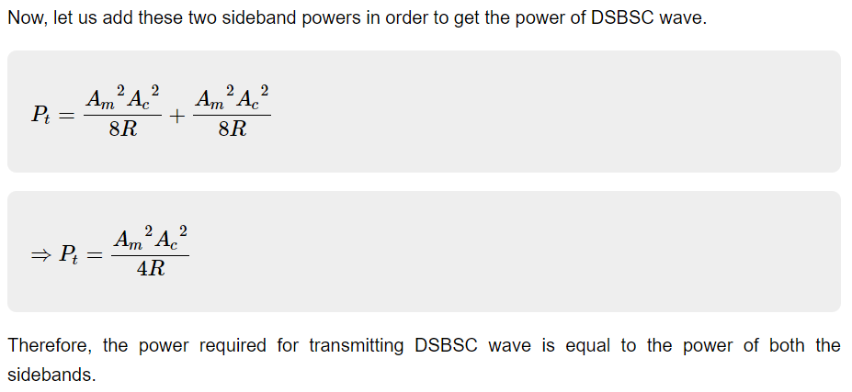

Slide 8
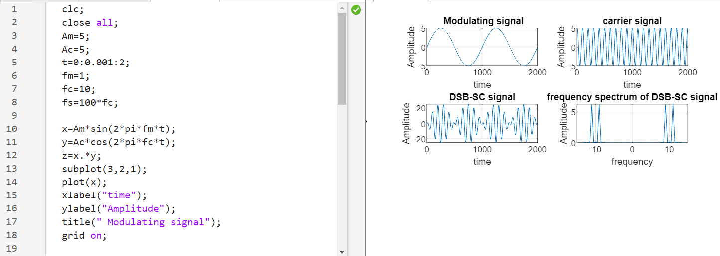
MATLAB code:

Slide 9
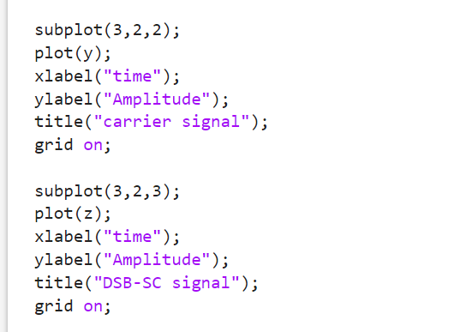
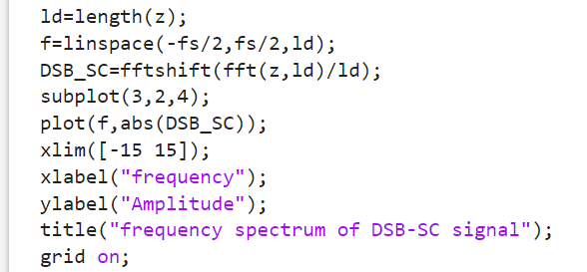
DSBSC Modulation and it’s frequency spectrum:

Slide 10
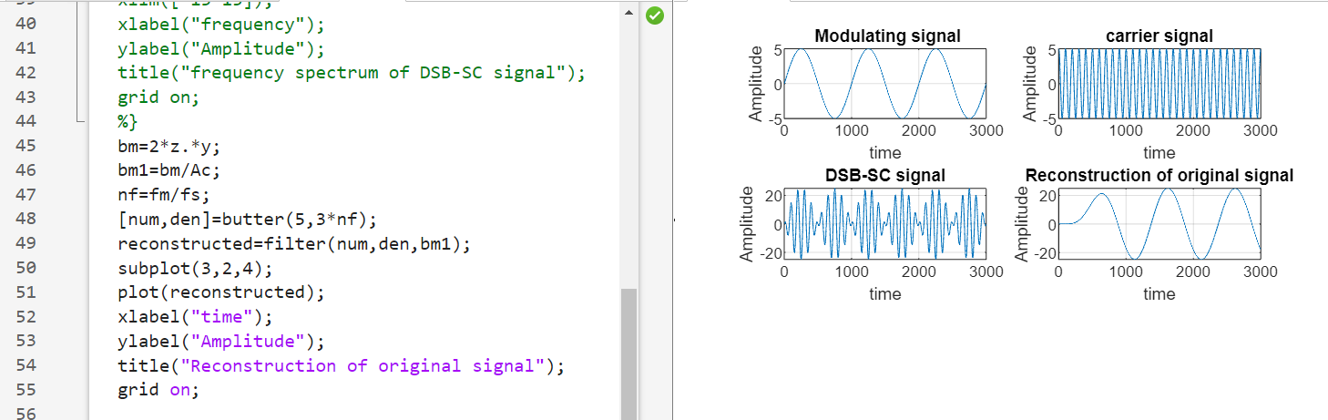
DSBSC Demodulation:

Slide 11
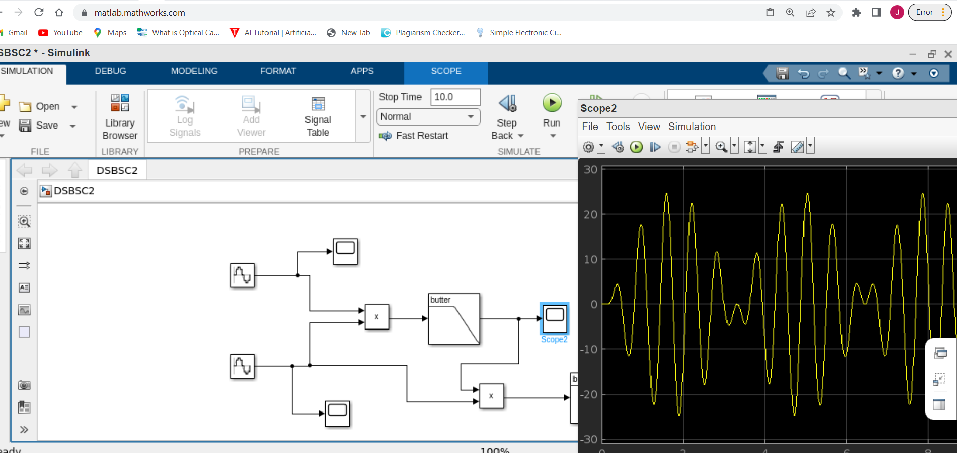
DSBSC Modulation:

Slide 12
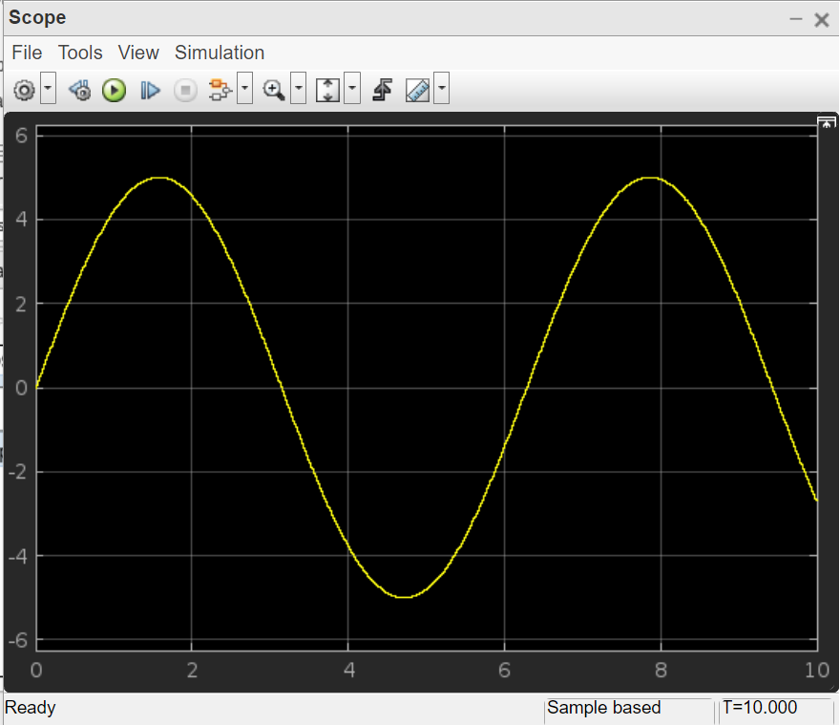
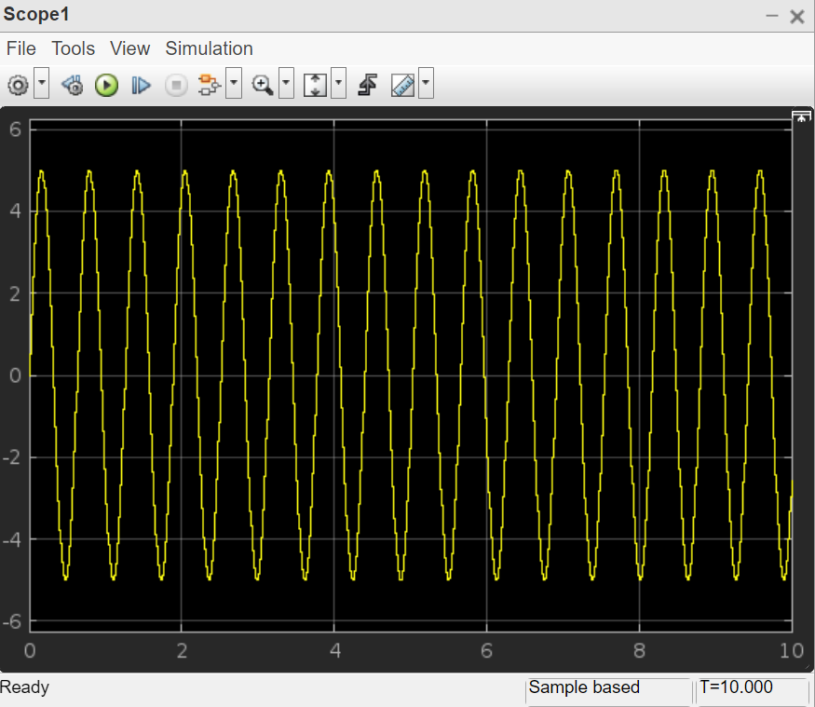
Modulating Signal
Carrier Signal

Slide 13
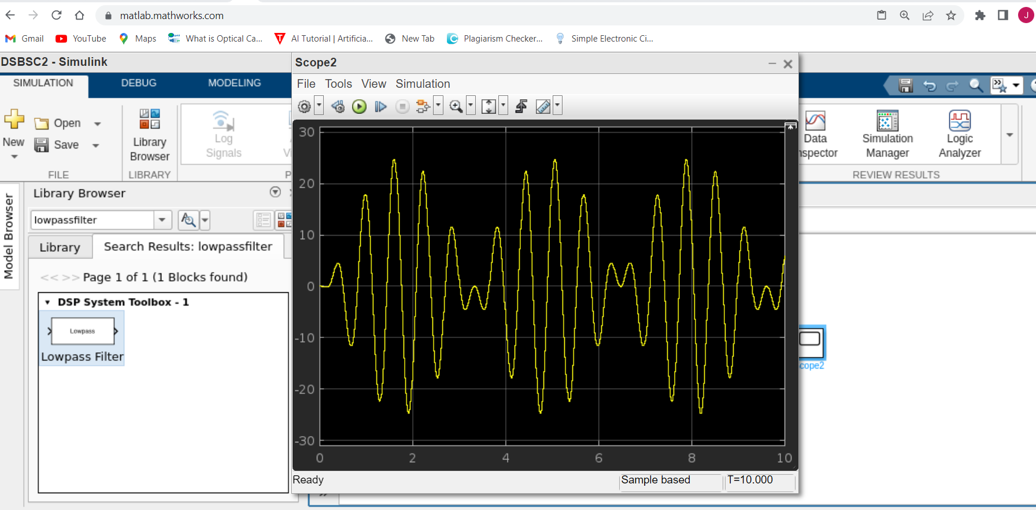
DSBSC Signal:

Slide 14
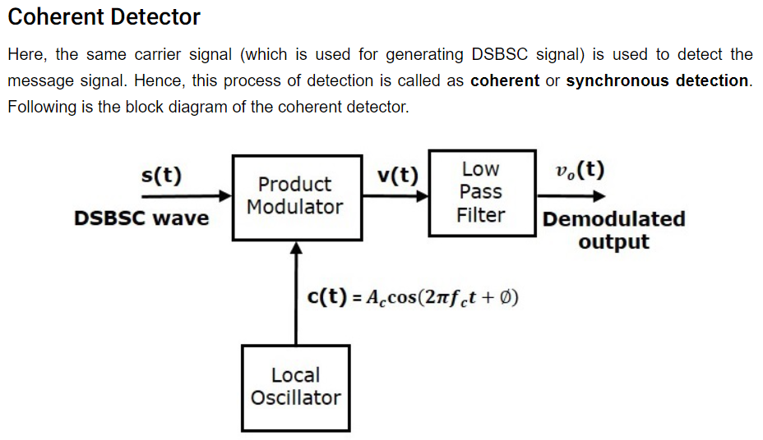

Slide 15
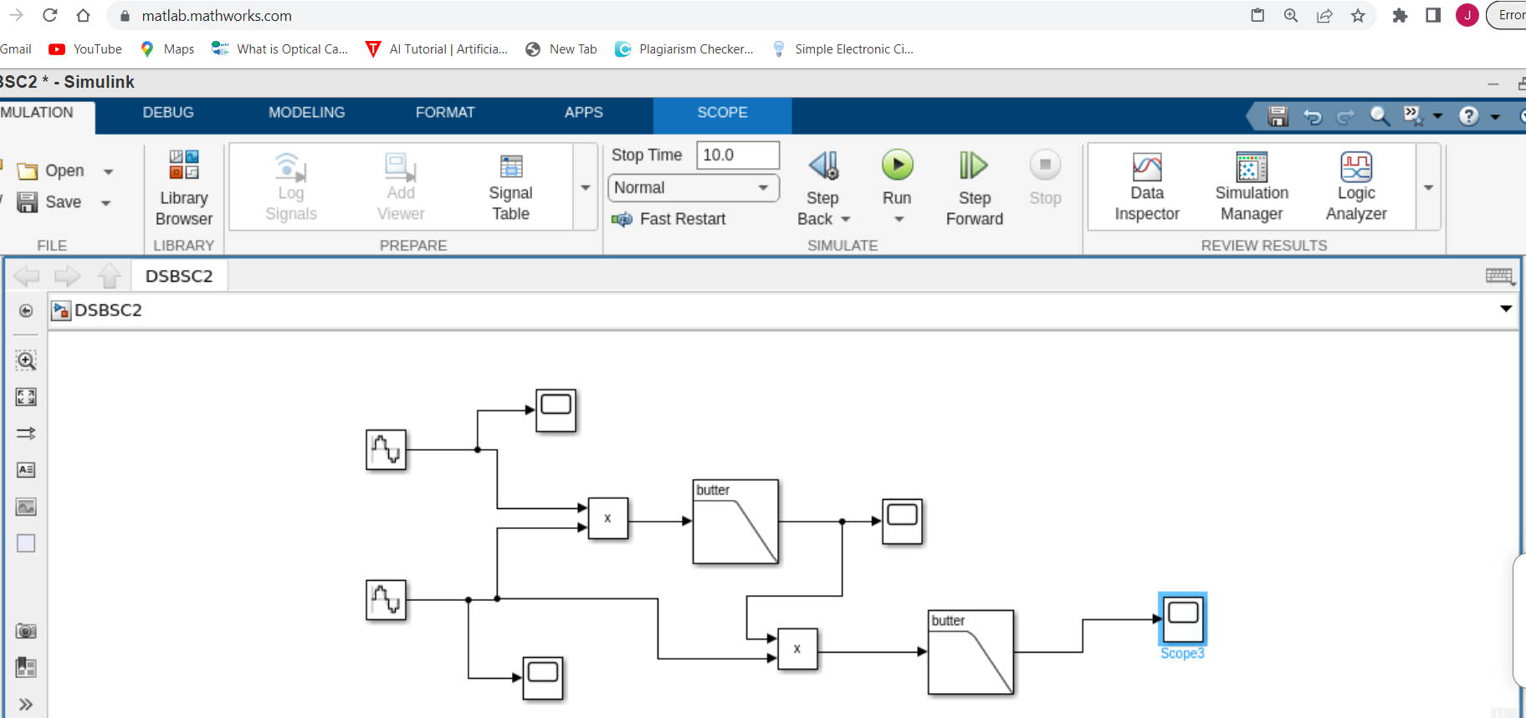
DSBSC Demodulator:

Slide 16
References:
[1]https://www.tutorialspoint.com/analog_communication/analog_communication_dsbsc_demodulators.htm

